Slide 2
Special Needs Program Training
Quality Management Department

Slide 3
Special Needs Plan (SNP) Overview

Slide 4

SNP Overview
Medicare Advantage (MA) plans were created by the Medicare Modernization Act of 2003 (MMA)
Special Needs Plans (SNPs) are a type of Medicare Advantage plan that includes Part C (medical) and Part D (drug) coverage
Provide coverage for vulnerable populations who have multiple conditions and barriers to participating in self-care management
Provide members with guidance and resources that help provide access to benefits and information

Slide 5

CMS Goal for Special Needs Plans (SNPs)
SNPs should emphasize monitoring health status, managing chronic diseases, avoiding inappropriate hospitalizations and helping members maintain or improve their health status

Slide 6
Types of SNP
There are 3 types of SNP programs that CMS offers:
  Institutional
  Dual Eligible
  Chronic
Institutional (I-SNP)- Beneficiaries who reside, or are expected to reside, for 90 days or longer in a long term care facility – defined as skilled nursing facility (SNF) nursing facility (NF), intermediate care facility (ICF) or inpatient psychiatric facility OR those who live in the community but require an equivalent level of care to those who reside in a long term care facility.
Dually Eligible (D-SNP or DE-SNP)- Beneficiaries who qualify for both Medicare and Medicaid coverage.
Chronic Condition (C-SNP)- Beneficiaries with targeted chronic conditions such as cardiovascular disease, diabetes, congestive heart failure, osteoarthritis, mental disorders, ESRD, or HIV/AID

Slide 7
SNP Participation
Why participate in a SNP Program?
AHC’s clinical model is established in a way that we are already catering to the chronically ill and those with special needs
Establishing a formal SNP plan allows for opportunities to open enrollment to the population in need throughout the year, provide greater benefits to the population and receive rates in line with the member’s condition
What Makes a SNP Product Unique?
Plan benefit packages are developed with the SNP populations in mind
  Example – C-SNP packages are developed with generally richer benefits than standard MAPD plans in areas that help support the health maintenance of the plan members such as $0 to low cost diabetic supplies

Slide 8
How Do Members Enroll in a C-SNP?
Qualifying Condition
Members who have been diagnosed with a qualifying condition have a continuous Special Enrollment Period (SEP) to join a C-SNP at any time, but are locked in to the C-SNP after selection, like any other MAPD plan, until the next Annual Enrollment period (AEP).
Verification of Chronic Condition
Verification of a chronic condition is required by the end of their effective month per CMS and must be signed by the provider or an authorized employee of the provider’s office
Termination from
C-SNP
If verification is not completed by the last day of the 2nd month of enrollment, the member will be terminated from the C-SNP plan and transitioned to a regular MAPD plan
Attempts to obtain eligibility verification information from an enrollee’s existing provider using methods other than telephone contact (CMS 40.2.1)

Slide 9
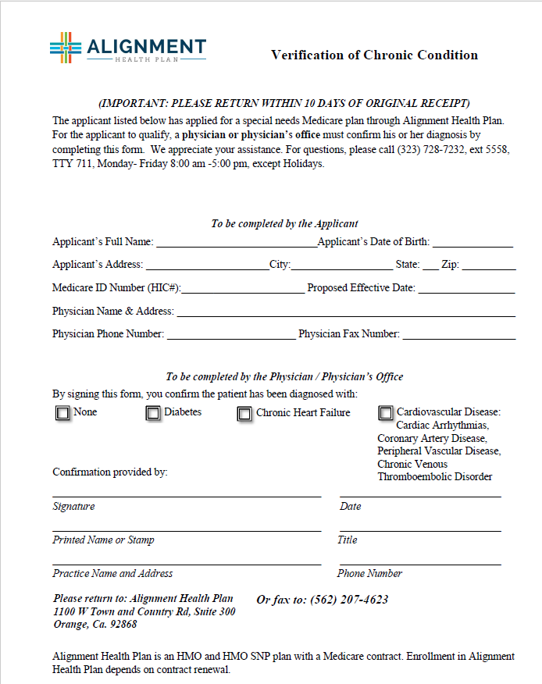
Verification of Enrollment Form

Slide 10
Alignment Health Plan Model of Care

Slide 11

Alignment Health Plan (CA)
Model of Care
Offered in Los Angeles County and Orange County only
Chronic Conditions SNP (C-SNP)
  Diabetes, Chronic Heart Failure, Cardiovascular Disease
Plan Benefit Package– H3815-010
Product Name: Heart & Diabetes (HMO SNP)
C-SNP Case Management is NOT Delegated to MSOs or IPAs

Slide 12

California (AHP) SNP Plans
LA County
Orange County

Slide 13
Model of Care Overview

Slide 14


What is a Model of Care?
A SNP Model of Care (MOC) is considered a vital quality improvement tool and integral component for ensuring that the unique needs of each member enrolled in a SNP are identified and addressed.
The MOC is a fundamental component of SNP quality improvement so CMS requires the National Committee for Quality Assurance (NCQA) to review and approve SNPs’ MOC based on standards and scoring criteria established by CMS.
A MOC is required for each SNP type
10

Slide 15
Model of Care Goals
To improve access to affordable medical, mental health and social services
To improve coordination of care through an identified point of contact
To create seamless transitions across the health care setting, health care providers and health services
To improve access to preventive care services
To improve the appropriate utilization of services
To facilitate delivery of cost-effective health services
To improve members’ health outcomes through reduction of admissions, improved self-management, functional status, improved pain management and improved quality of life
10

Slide 16
MOC Elements
The MOC requirements comprise the following clinical and non-clinical standards:
Element 1-
Element 2-
Element 3-
Care Transition Protocols
Description of the SNP Population
Care Coordination
SNP Provider Network
MOC Quality Measurement and Performance Improvement
Element 4-
10

Slide 17
MOC Element 1- Description of SNP Population

Slide 18
MOC Element 1:
Description of SNP Population
Element A- Overall SNP Population
  Identify and describe the target population, including health and social factors, and unique characteristics of each SNP Type
  Describe how the staff will determine, verify and track eligibility of SNP members
  Describe the social, cognitive and environmental factors, living conditions and co-morbidities associated with the SNP population
  Identify and describe the medical and health conditions impacting SNP members
  Define the unique characteristics of the SNP population served
Element B- Most Vulnerable Members
  Defines and identifies the most vulnerable members within the SNP population and provides a complete description of specially tailored services
  Explains how the average age, gender, ethnicity, language barriers, deficits in health literacy, poor socioeconomic status, affect the health outcomes of the most vulnerable
  Correlates between demographic and the unique clinical requirements
  Identifies and describes established relationships with partners in the community to provide needed services

Slide 19
MOC Element 2-
Care Coordination
Health Risk Assessment

Slide 20

MOC Element 2:
Care Coordination
Element A- SNP Staff Structure
  Administrative and clinical staff roles and responsibilities
  How care coordination occurs
Element B- Health Risk Assessment Tool
  How the HRAT is used to develop the ICP
  Dissemination of information to the ICT
  Process for conducting initial and annual assessments
  Methodology used to review, analyze and stratify HRA results
Element C- Individualized Care Plans (ICPs)
  Describe elements of the ICP
  Process for Development/Modification
  Documentation, Mantainence and Communication
Element D- Interdisciplinary Care Team (ICT)
  Key Members of ICT
  Roles/responsibilities
  How the ICT contributes to improving member health status
  Communications within the ICT
Element E- Care Transition Protocols
  Type of health care settings and personnel responsible for care transitions
  How the elements of the member’s ICP is shared between settings and who has access
  Describe the point of contact throughout the transition process

Slide 21
The Health Risk Assessment (HRA)
A Health Risk Assessment (HRA) is required for all members enrolled in a SNP
The HRA is a tool used to identify member risk levels including but not limited to: Health, Functional, Cognitive, Psychosocial / Mental Health
All SNP members must have a completed Initial HRA within 90 calendar days of enrollment or with any change of Plan Benefit Package (PBP).
Annually, members require an HRA within 365 calendar days of their previous HRA or enrollment date
HRAs should be repeated when there is a major health status change or care transition.
The HRA may be completed face-to-face, telephonically or written
CMS requires a minimum 3 outreach attempts and a letter within 30 calendar days in the first 90 calendar days for initial and 90 calendar days prior to the annual HRA due date when an HRA is not completed
The HRA must be reviewed, analyzed and stratified by the Case Manager within 30 calendar days of administering the HRA.
HRA completion rates are CMS STAR Measures!

Slide 22
Health Risk Assessment Tool (HRAT)
To accommodate member preferences, AHC has several ways to complete an HRA
Jumpstart Visit
Comprehensive Assessment
Telephonic HRA
Paper HRA
NP/PA/MD
HRA
Member
RN Case Mgr
JSA Outreach Team

Slide 23

Jump Start Assessment
The Jump Start Assessment (JSA) is performed in person at either a Care Center or as an in home assessment
The JSA meets the HRA requirements of the MOC and Star measures
The JSA consists of the following:
    120+ point assessment
    A head to toe physical
    Lab work - blood and urine collection.
    Review of current and past medical history.
    Review of medications, to include any over the counter (OTC) drugs.
    Assessment to determine other health needs or screenings as needed to address individual health concerns.
    Referrals for further testing and chronic disease management clinics.
    Results are shared with member’s PCP and we work together to coordinate and manage care.
    Referrals for specialty care and disease management programs as necessary
    Assist in completing HEDIS measures
    Review of advanced directives

Slide 24


Paper Health Risk Assessment
Telephonic Health Risk Assessment
Subset of the Jumpstart Visit Assessment questions
Can be asked over the telephone by non-clinical staff- JSA Outreach Team
Questions include:
  Self reported health status
  Tobacco and Alcohol usage
  Marital Status
  Living situation
  Caregiver support
  ADLs (Barthel Index)
  Fall history
  PHQ-2
  Community Assessment Risk Screen (CARS)
    Hospitalizations
    Emergency Room or Urgent Care Visits
    Chronic conditions
    > 5 Medications
  Advance Directives
  Medical Supplies or Home care services
  Dialysis service
  Specialist Care
  Used when unable to contact a member or member refuses
  Sent at the member’s request
  Includes same questions as the Telephonic HRA
  Sent for annual reassessments

Slide 25
The Comprehensive Assessment
This is an Assessment of the Member’s health status based on NCQA® standards
This is a stand alone assessment which should be used for all members engaged in Case Management
The Comprehensive Assessment consists of the following :
  Member health status including condition-specific issues
  Member’s clinical history; including medications
  Activities of daily living
  Behavioral health status, including cognitive functions
  Psychosocial issues
  Cultural and linguistic needs, preferences, or limitations
  Visual and hearing needs, preferences, or limitations
  Caregiver resources and involvement
  Available benefits (Value-added services such as in-home survey, social services, pharmacy, education, dietitian and behavioral health)
  Available community resources
  Life-planning activities including advanced directives, living wills, and hospice
25

Slide 26
MOC Element 2- Care Coordination
Individualized Care Plan

Slide 27
Care Plan Basics
A Care Plan is a vehicle used to facilitate the nursing process
Allows us to clarify most urgent or priority interventions
A Care Plan serves as written blueprint to carry out nursing actions
Care Plans are used as a communication tool to the member and the PCP

Slide 28
The Individualized Care Plan (ICP)
An Individualized Care Plan (ICP) outlines health related goals and is developed by the Case Manager with the member and is communicated to the member’s PCP to contribute relevant clinical information.
The ICP must be initiated or updated within 30 calendar days from the referral to CM or from the initial or most recent HRA
If a member is unable to contact or refuses to complete an HRA, a care plan is created using available information such as Command Center, Utilization or claims data
Goals must be individualized and prioritized based on the member’s identified needs
    Include both short and long term goals
    Include time frame for evaluation
The CP must include interventions for all needs identified from the Health Risk Assessment and Comprehensive Assessment
The CP is required to be updated and reviewed with the member throughout the calendar year or until all goals are met

Slide 29
MOC Element 2- Care Coordination
Care Transition

Slide 30
Care Transitions
Members who experience a care transition are vulnerable to receiving fragmented and unsafe care when they move from one setting to another
Care transition settings include home, home health, acute care, skilled/custodial nursing facilities, rehabilitation facility, outpatient/ambulatory care/surgery centers
Care Transition support needs are addressed by the Case Manager in order to maximize member recovery and avoid preventable transitions
During any transition of care, it is the responsibility of the Case Manager to share the members individualized care plan with the receiving setting.
As the member’s primary point of contact during a transition, the case manager should:
  Provide the member with educational materials and ensure member has understanding of health changes.
  Verify physician appointments are made
  Ensure the member has an understanding of post-discharge plan and instructions
  Verify ordered Home Health and Durable Medical Equipment supplies are in place
  Provider member and caregiver support/training
  Reconcile medications
All applicable ICT members are informed of the member’s needs pre, during and post transition from one care setting to another including the receiving facility

Slide 31
MOC Element 3- Provider Network

Slide 32

MOC Element 3:
Provider Network
Element A- Special Expertise
  The specialized expertise in the provider network addresses the needs of the target population as described in MOC 1
  How the SNP oversees the licensure and certification of providers
  Documentation of provider information
  Collaboration between the providers and ICT to provide necessary specialized services
Element B- Use of Clinical Practice Guidelines and Care Transition Protocols
  Monitoring how providers utilize CPG and nationally-recognized protocols appropriately
  Identify challenges where CPG and protocols need to be modified
  Decisions to modify CPGs and acted upon by the ICT
  Oversees the use of care transition protocols to maintain continuity of care
Element C- Provider Network Training
  Initial and annual trainings for network and out-of-network providers seen by members on a routine basis
  Offering MOC trainings to all network providers
  Challenges associated with completion of MOC trainings
  Actions taken when training is not complete

Slide 33
MOC Element 4- Quality Measurement and Performance Improvement

Slide 34

MOC Element 4-
Quality Measurement and Performance Improvement
Element A- Quality Performance Improvement Plan
  Plan-level information focusing on goals that measure overall plan performance related to all aspects of the MOC
Element B- Measureable Goals and Health Outcomes for the MOC
  Plan-level measures and goals for the target population
  Health/clinical goals (e.g., controlling diabetes, mental health screening)
Element C- Measuring Patient Experience of Care
  Plans may use wide variety of patient experience/satisfaction surveys—CAHPS/HOS are acceptable, as are other alternatives
  Provide details of surveys and methodology for data collection
  Describe how results of patient experience surveys are integrated into the overall MOC performance improvement plan
  Describe steps taken by the SNP to address issues identified in survey responses
Element D- MOC Ongoing Performance Improvement Evaluation of the MOC
  How the SNP uses the results from its performance indicators/measures to support its ongoing quality improvement plan including lessons learned and challenges in obtaining timely data.
Element E- Dissemination of SNP Quality Performance
  Detail who receives the information, how often they receive it, and what communication methods are used

Slide 35
Responsibilities

Slide 36

Member Requirements
As part of the SNP Program, members should be active participants in support of their healthcare.
  Members should participate in AHP Case Management to develop their care plan
  Work with their Interdisciplinary Care Team to work toward goals

Slide 37

Provider Responsibilities-
Participation and Communication
PCPs will receive a copy of the member care plans throughout the year for all new C-SNP patients and existing patients.
You will receive updates to the care plan if there is a change in condition, after a care transition or annually.
Your participation ensures your patient understands their care plan and receives needed care

Slide 38

Provider Responsibilities-
Participation and Communication
Assess/re-assess your patient to identify health status changes and update the Individualized Care Plan (ICP)
Discuss the care plan with your patient
Communicate with the Interdisciplinary Care Team (ICT) to ensure coordination of care and transition of care for your patient
Refer your patients to the Alignment Case Management Program
Participate and support Alignment Health Plan’s quality improvement initiatives
Participate in Alignment Health Plan’s provider satisfaction survey

Slide 39

Who is Responsible For Compliance With The SNP Model Of Care?
!
Compliance with CMS requirements and the ethical administration of the Alignment Health Plan and Alignment Healthcare SNP MOCs is a enterprise-wide, shared responsibility.
If processes, process changes, meetings, trainings and communications are not documented they do not exist with CMS!

Slide 40

Regulatory References
CMS Medicare Managed Care Manual- Chapter 16b- Special Needs Plans
42 C.F.R. §§ 422.2
Social Security Act Section 1859 (b)(6)(B)(iii)
CMS Medicare Managed Care Manual Chapter– Enrollment Guidelines
CMS Medicare Managed Care Manual Chapter 3 – Marketing Guidelines
CMS Medicare Managed Care Manual Chapter 4 – Beneficiary Protections
MMCM Chapter 8
NCQA® Model of Care Scoring guidelines
Medicare Part C Plan Reporting Requirements Technical Specifications Document Number 13 for “SNP Care Management”

Slide 41
Model of Care Attestation Page

Slide 42
Delegate Representative Attestation
Special Needs Plans (SNP) Model of Care Training Attestation
I, ____________________________________, hereby attest that the attached listed providers have completed the Special Needs Plan (SNP) Model of Care Training.
The listed providers understand the Model of Care and the role in improving health outcomes for the most vulnerable population.
It is understood that the annual training is mandatory for all providers that care for SNP members and is required by the Centers for Medicare and Medicaid Services (CMS).
Name:_______________________________________ Date:__________________________
Signature_____________________________________________________________________
IPA: _________________________________________________________________________
Please return completed attestation and provider signature list to:
AHP Quality Department
Email to QI@ahcusa.com
or send via fax 562-207-4617

Slide 43
PROVIDERS SIGNATURE LIST
Purpose: Special Needs (SNP) Model of Care (MOC) annual training is mandatory and is required by the Centers for Medicare and Medicaid Services (CMS) for all Medicare Advantage Special Needs Plan providers.
Instructions: Upon review of training, please provide your printed name, signature and training completion date.
Print Name:
Signature:
Training Completion Date:
PRINT NAME:jjjjj | SIGNATURE: | TRAINING COMPLETION DATE:

