Slide 1
Model of Care- Provider Program
This Model of Care Program only applies to those Members enrolled in Freedom and Access plans
Developed by: Quality Improvement
Revised: 09/24/2015
EC Internal Approval_086_MOC_Provider Program_10152015

Slide 2
Model of Care - Provider Program

Slide 3
Key Terms and Acronyms
Term / Acronym | Definition
Dual Special Needs Plans (D-SNPs) | A type of Medicare Advantage Coordinated Care Plan focused on dual-eligible Medicare beneficiaries. D-SNPs offer the opportunity of enhanced benefits by combining Medicare and Medicaid cost sharing and/or benefits available. D-SNP providers will help dual eligible members access needed services through both their Medicare and Medicaid wraparound benefits for which they are eligible.
Health Risk Assessment (HRA) | The HRA is a tool used to determine the Member’s level of health and functioning.
Individualized Care Plan (ICP) | Developed by the Interdisciplinary Care Team based upon the HRA and comprehensive assessment of the member, with input from the member/caregiver, provider(s), and a care manager.
Interdisciplinary Care Team (ICT) | The ICT includes the member’s care manager, caregiver (if applicable), primary care physician, and any other health care professional providing care to the member. Examples of health care professionals are the member’s pharmacist, specialist providers, nurses, etc.

Slide 4
Key Terms and Acronyms
Term / Acronym | Definition
Medicare Improvements for Patients and Providers Act (MIPPA) | Passed by Congress, the Medicare Improvements for Patients and Providers Act (MIPPA) amends the requirements applicable to Special Needs Plans (SNPs) for plan years as of January 1, 2010. MIPPA includes new policies requiring Medicare Advantage plans to institute accountability measures to reduce health disparities through increased access to preventive and mental health services.
Special Needs Plans (SNPs) | A type of Medicare Advantage Coordinated Care Plan focused on certain vulnerable groups of Medicare beneficiaries including: Institutionalized Dual-eligible Beneficiaries with severe or disabling chronic conditions SNPs are designed to improve care for Medicare beneficiaries with special needs through improved coordination and continuity of care.

Slide 5
Objectives
Upon completing this training, clinical personnel will be able to:
Describe Easy Choice Health Plan Model of Care (MOC) Program
Explain the member experience related to Easy Choice’s MOC Program
Identify what provider participation is needed to make Easy Choice Health Plan’s MOC Program a success
Locate supplemental documentation relating to Easy Choice Health Plan’s MOC Program including:
The provider notice
The D-SNP Model of Care Self-Study Program
A sample care plan
Attest they were presented with, read, and understood the educational materials for the Easy Choice Health Plan Model of Care for D-SNP members

Slide 6
Model of Care Overview
Our Model of Care Program helps to improve Easy Choice Health Plan’s dual-eligible members’ access to services and coordination of care.
The Medicare Improvements for Patients and Providers Act (MIPPA) of 2008 includes:
New policies to “reduce racial and ethnic health disparities” within the Medicare population.
New accountability measures for Medicare Advantage (MA) plans to “increase access to preventive and mental health services.”
D-SNP’s and providers will help dual-eligible members access needed services through both their Medicare and Medicaid wraparound benefits for which they are eligible.

Slide 7
Model of Care Overview
Our focused Model of Care Program targets dual-eligible members enrolled in one of our Dual Special Needs (D-SNP) Plans:
Access D-SNPs are available in Fresno, San Joaquin and Stanislaus Counties
Freedom D-SNPs are available in Los Angeles County.
The program targets improvement by:
Coordinating care through Case Management
Coordinating Transitions of Care across health care settings and providers
Providing access to preventive health services including medical, social and mental services designed to improve member health

Slide 8
Model of Care – Provider Version
The Member Experience

Slide 9
The Member Experience - HRA
All Easy Choice Health Plan D-SNP Members will be outreached to receive a comprehensive Health Risk Assessment (HRA) to identify individual needs.
The HRA determines the member’s level of health and functioning by using this and a comprehensive assessment conducted by a case manager.
Easy Choice Health Plan, with the help of the member/designated caregiver and the member’s provider(s), develops an ICP for each D-SNP member.

Slide 10
The Member Experience – Case Management
Each HRA is reviewed by a case manager to:
Assess the member’s current medical and psychosocial needs
Identify members of the Interdisciplinary Care Team (ICT)
The ICT is comprised of:
Member’s case manager
Member/caregiver (if applicable)
Primary care physician (PCP)
Any other health care professional providing care to the member including:
Member’s pharmacist, any specialist providers, nurses, etc.
Anyone the member wishes to attend (e.g., spouse, children)

Slide 11
The Member Experience – Case Management
If the case manager is unable to contact the member once the initial HRA is completed or the member refuses to enroll in care management:
A clinical review of the HRA will be performed, an ICP will be developed based on the findings and the PCP will be sent a letter and a copy of the ICP for further review

Slide 12
The Member Experience – Case Management
Following the HRA, all D-SNP members who choose to participate in the Case Management Program will:
Complete a Comprehensive Assessment, conducted by a case manager, to be used with the HRA and Clinical Practice Guidelines to develop the Individualized Care Plan (“care plan”).
Participate with a case manager to develop and agree upon their care plan. This will be shared with the members of the ICT for input and finalization of the member’s care plan.
Receive regular telephonic contact with their assigned case manager to monitor progress/regression towards goals of the care plan.
Benefit from ongoing communication between the case manager and other members of the ICT.
Receive at minimum, an annual HRA.
Low | Medium | High
Note: Members can expect to move “up” or “down” the continuum of care based on their changing health care needs

Slide 13
Model of Care – Provider Version
Provider Participation

Slide 14
Provider Participation
What If no case management?
D-SNP members who can’t be contacted by Easy Choice Health Plan or who refuse the Case Management Program:
Will have an initial communication plan created and sent to their usual practitioner to:
Obtain additional information about the member
Individualize the member’s care plan.
We encourage the PCPs to discuss case management participation with their members and refer them to us at any time
Care Transitions
All D-SNP members who undergo a transition of care from one setting to any other setting will receive:
Communication from case management
Contact after discharge from one level of care to the next or home
Education on transition and transition prevention
Providers will receive communication about the member’s transition and any other status changes related to the member’s health.

Slide 15
Provider Participation - Collaboration
Ongoing participation from members and providers is essential to the success of the MOC program.
As the medical home for D-SNP members, you are a necessary participant on the member’s ICT.
Easy Choice Health Plan requests your ongoing participation to ensure that D-SNP members have comprehensive access to services and meaningful coordination of care.

Slide 16
Provider Participation - Responsibilities
You as a provider, are responsible for:
Reviewing the proposed care plan faxed for each Easy Choice Health Plan D-SNP member for whom you provide care
Providing any necessary additional information about the member’s care to ensure that the care plan is complete and accurate
Updating each care plan when necessary by faxing any changes or additions back to Easy Choice Health Plan
Discussing the care plan with each Easy Choice Health Plan D-SNP member for whom you provide care
Communicating with the ICT as requested to ensure optimal coordination of care and transition of care for the member
Encouraging member participation in case management

Slide 17
Provider Participation - Communication
You will receive member care plans throughout the year for existing and new members, including each time the care plan is updated.
Both members and providers can expect communication in the following ways:
Mail
Telephone
Fax (providers only)
Your participation ensures the member understands their care plan and receives needed care.
Case managers will facilitate regular communication with the provider on behalf of the members.
To reach Easy Choice Health Plan’s Case Management Department, call 1-866-999-3945 Monday- Friday, 8:00 a.m. to 5:00 p.m.
Notes:
12/19/2016 10:04:07 AM
P.17

Slide 18
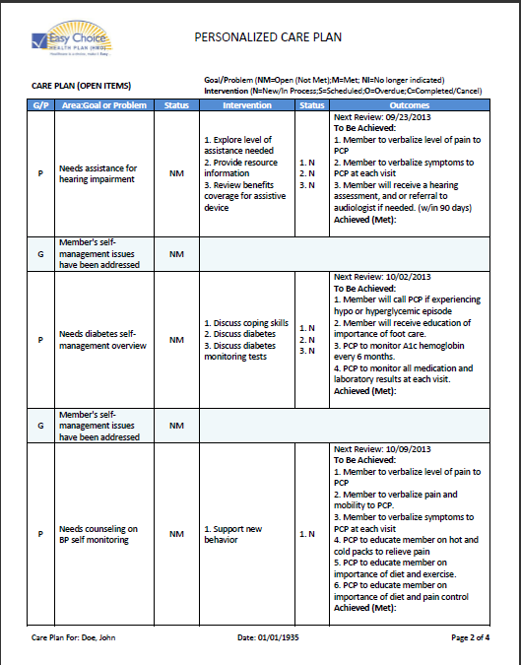
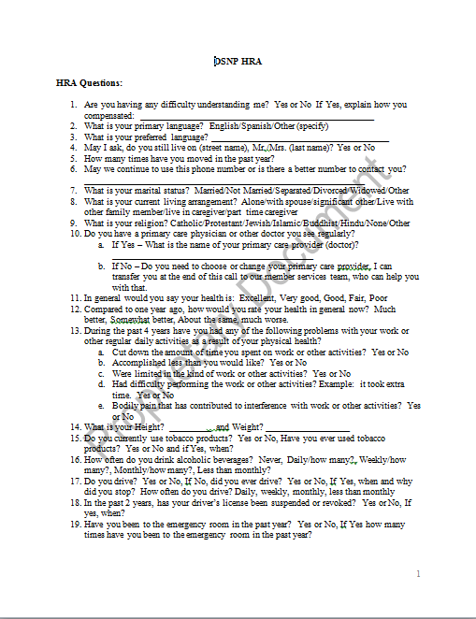
Model of Care – Provider Version
D-SNP MOC Self-Study Program Sample
Care Plan Sample
Health Risk Assessment Sample
Supplements

Slide 19
Supplements
Easy Choice Health Plan has provided Model of Care supplements to aid your participation.
These supplements can be found on the Easy Choice Health Plan.com website.
To access these materials, follow these instructions:
Type the address below into your web browser address bar
http://www.easychoicehealthplan.com/provider.php

Slide 20
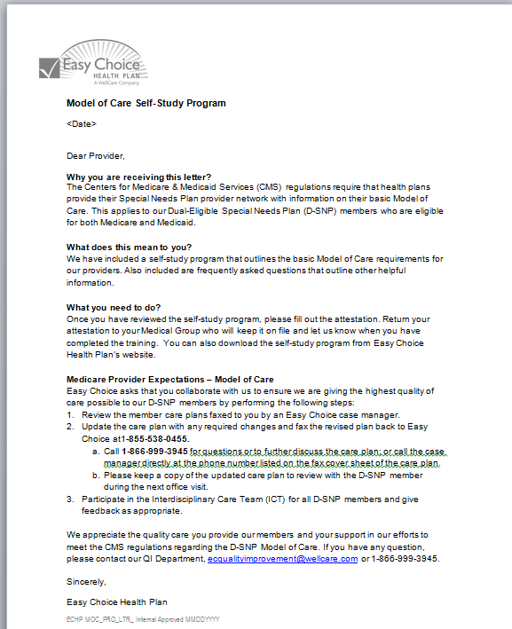
Supplements
Provider Notice (Letter)
Is a notice sent via fax to all PCPs of Easy Choice Health Plan D-SNP members.
If you did not receive the fax, please provide a correct fax number to your representative to ensure you receive important notifications in the future.
Please select the appropriate state resources for the most accurate information.
A copy of this document can be found on the Easy Choice Health Plan Website

Slide 21
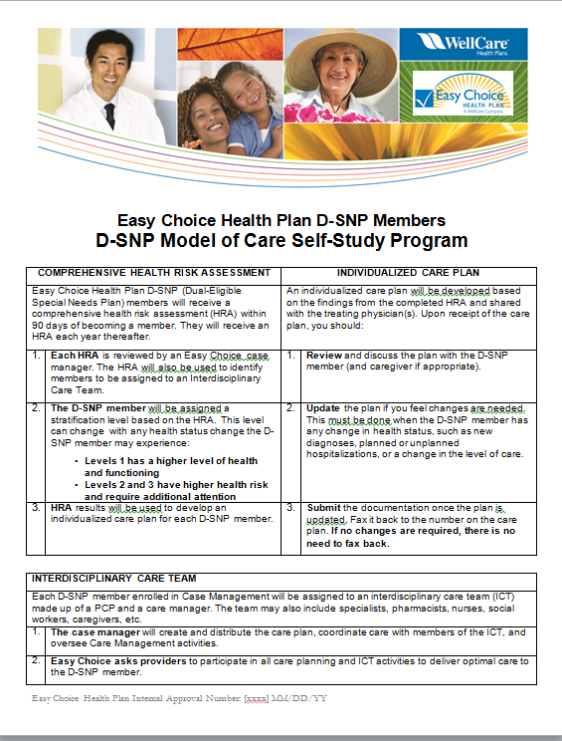
Supplements
D-SNP Model of Care Self-Study Program
Is a quick reference tool outlining your responsibilities
A copy of this document can be found on the Easy Choice Health Plan Website
Notes:
12/19/2016 10:04:07 AM
P.21

Slide 22
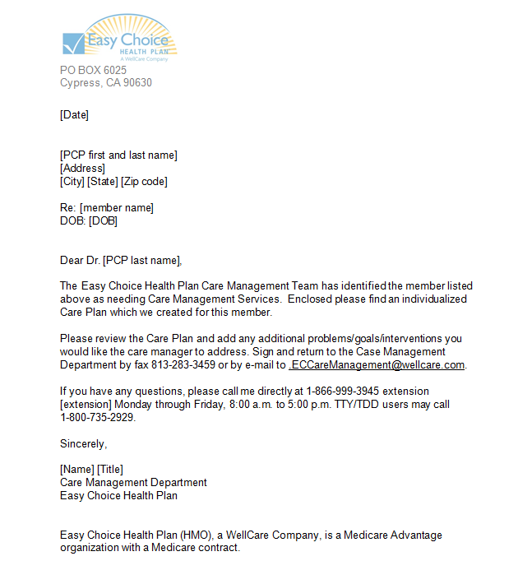
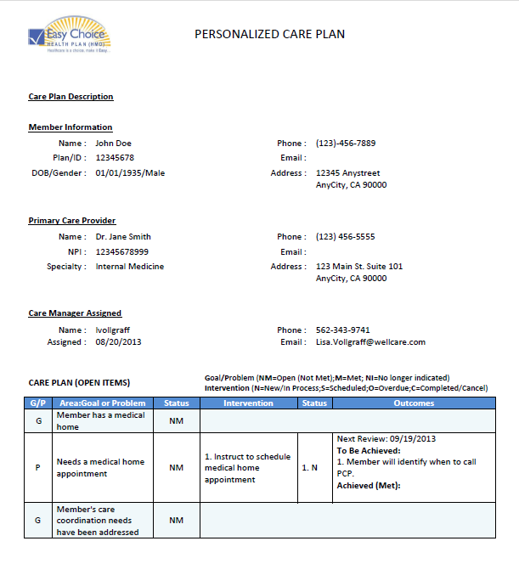
Supplements
Sample Care Plan
This is a sample of an Easy Choice Health Plan care plan and letter and what information is included.
A copy of this document can be found on the Easy Choice Health Plan Website
Sample Care Plan Letter
Sample Care Plan
Notes:
12/19/2016 10:04:07 AM
P.22

Slide 23
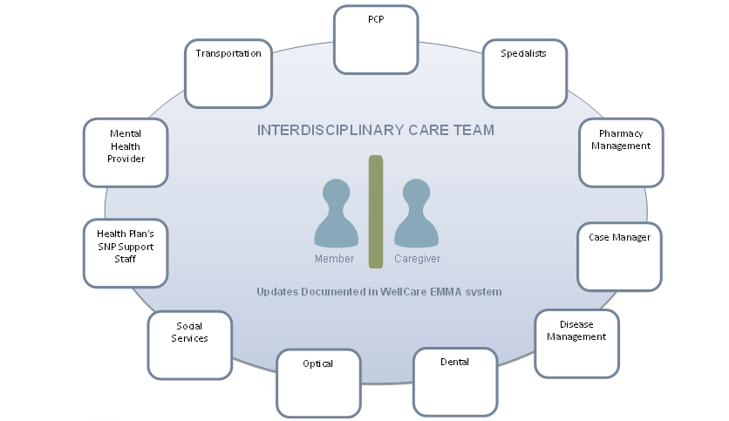
Interdisciplinary Care Team Composition
PCP
Medical
Home
Medical
Home
Transportation
Specialists
Mental Health
Provider
Pharmacy
Management
Health Plan’s
SNP Support
Staff
Care Manager
Updates Documented in Easy Choice Health Plan System.
Social Services
Disease Management
Optical
Dental

Slide 24
Summary
After completing this training, you should now be able to:
Describe Easy Choice Health Plan’s Model of Care (MOC) Program
Explain the member experience related to Easy Choice Health Plan’s MOC Program
Identify what provider participation is needed to make Easy Choice Health Plan’s MOC Program a success
Locate Supplemental Documentation relating to Easy Choice Health Plan’s MOC Program including:
The provider notice
The D-SNP Model of Care Self-Study Program
A sample care plan
Attest you were presented with, read, and understood the educational materials for the Easy Choice Health Plan Model of Care for D-SNP members

Slide 25
Training Completion Attestation
We hope you have found the Model Of Care Training helpful
There is one last step in completing this training: the attestation
For reporting purposes, you must now verify that you have completed this training.
If you do not complete the attestation form for this training, our reporting will indicate you have not completed this requirement and YOU WILL NOT BE IN COMPLIANCE.
To send the attestation follow these instructions:
1.Print the Attestation Form (on the next slide)
2.Complete the Attestation Form
3.Scan and save the completed Attestation Form to your computer
4.Return to your IPA/Medical Group Representative
We very much appreciate your collaboration and the care and services you provide to your patients – our members.

Slide 26
Attestation for Model of Care Training – Provider
_________ I attest that I have received and read the WellCare/ Easy Choice Health Plan Model of Care (MOC) training. (Centers for Medicare and Medicaid (CMS) Regulation 42 CFR §422.102(f)(2)(ii).
_________ I attest that I am willing to participate in the MOC requirements for the members for whom I provide care. Such activities may include providing information to the Case Manager, updating the care plan when necessary, discussing the care plan with the ECHP Case Manager and communicating with the Interdisciplinary Care Team as requested.
Signature: _________________________________________Printed Name: __________________________________
Date: ________________________________ Organization Name: _________________________________________
Return this attestation to your IPA Medical Group’s Representative for Easy Choice Health Plan

Slide 27
Attestation for Model of Care Training- IPA/Medical Group
_________ I attest that my organization and its contracted providers have received the WellCare/ Easy Choice Health Plan Model of Care (MOC) training. (Centers for Medicare and Medicaid (CMS) Regulation 42 CFR §422.102(f)(2)(ii).
_________ I attest that my organization has established a mechanism for compliance with the provider training requirement.
Your organization must establish a process for compliance, including but not limited to: dissemination to providers the WellCare / Easy Choice Health Plan MOC training, maintenance of all documentation including rosters, and a process for annual re-training.
_________ I attest that within sixty (60) days receipt of this notice, my organization will provide to WellCare / Easy Choice Health Plan a roster of all providers who received the training and a signed Attestation for WellCare / Easy Choice Health Plan Model of Care Training.
Providers that render services for members in the Dual-Special Needs Program (D-SNP) program are required to take the WellCare/ Easy Choice Health Plan MOC training.
Signature: _________________________________________Printed Name: __________________________________
Date: ________________________________ Organization Name: _________________________________________
Return this attestation to your Easy Choice Health Plan Representative
via email: ECProviderAttestations@wellcare

